Slide 1
UI Control using Hand Gesture Recognition
TEAM 5:
SREYA VENUGOPAL
HARITHA K V

Slide 2
ABSTRACT
With the increasing demand for touchless interactions, hand gesture recognition has become an essential technology in Human-Computer Interaction.
This project aims to develop a web-based hand gesture-controlled infographics where users can navigate pages using hand gestures. The system will utilize Google's MediaPipe for real-time hand tracking and Flask for web application development.

Slide 3
Objectives
Develop a web-based hand gesture-controlled infographics
Implement gesture recognition using MediaPipe
Integrate slideshow navigation using Flask

Slide 4
Understanding Hand Gesture Recognition
Hand gesture recognition is a computer vision technique that detects and interprets hand movements.
It is widely used in applications like:
Touchless UI (gesture-controlled interfaces)
Gaming (motion-based interactions)
Sign Language Translation
Virtual Reality (VR) and Augmented Reality (AR)

Slide 5
System Architecture
Webcam captures the user's hand gestures.
OpenCV and MediaPipe detect and recognize hand gestures.
Flask processes the recognized gestures and updates the slideshow index.
Frontend (JavaScript) uses AJAX to poll Flask for the latest slide index.
Slideshow updates based on the latest index received from Flask.

Slide 6
REQUIREMENTS
We need Python and the following libraries:
MediaPipe: For hand tracking
OpenCV: For capturing video from a webcam
Flask: To integrate the gesture-controlled UI with a web application

Slide 7
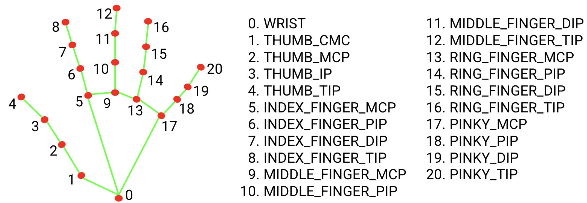
MEDIA PIPE
It is an open-source framework developed by Google that provides real-time hand-tracking capabilities.
The Hand Tracking module detects 21 key points (landmarks) on a hand using a camera.
Gesture classification model bundle
It can recognize these common hand gestures:
0 - Unrecognized gesture, label: Unknown
1 - Closed fist, label: Closed_Fist
2 - Open palm, label: Open_Palm
3 - Pointing up, label: Pointing_Up
4 - Thumbs down, label: Thumb_Down
5 - Thumbs up, label: Thumb_Up
6 - Victory, label: Victory
7 - Love, label: ILoveYou
Hand landmark model bundle

Slide 8
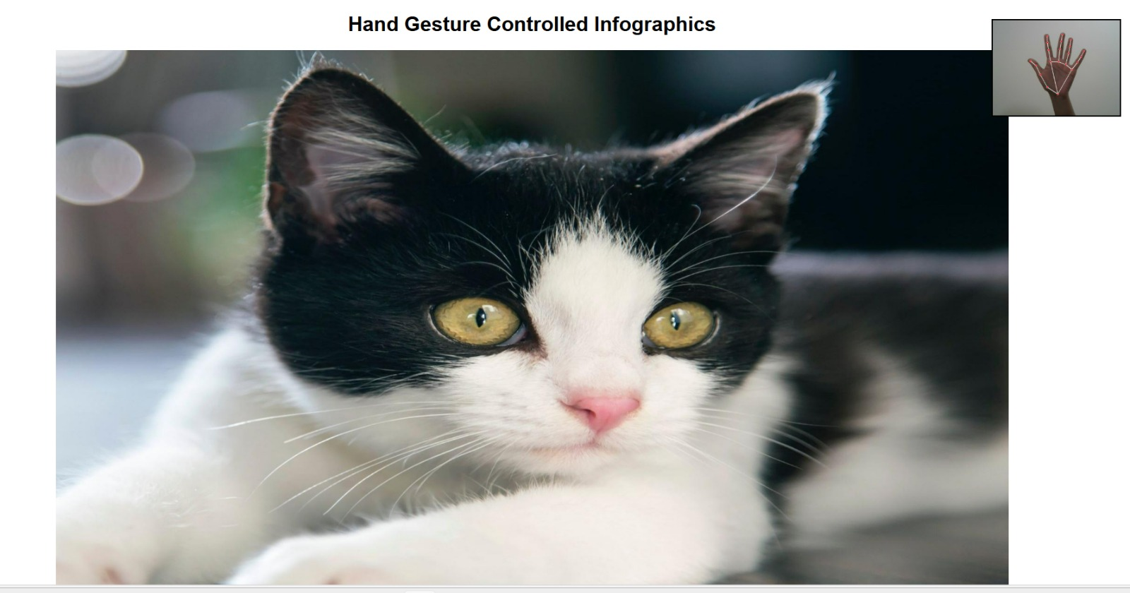
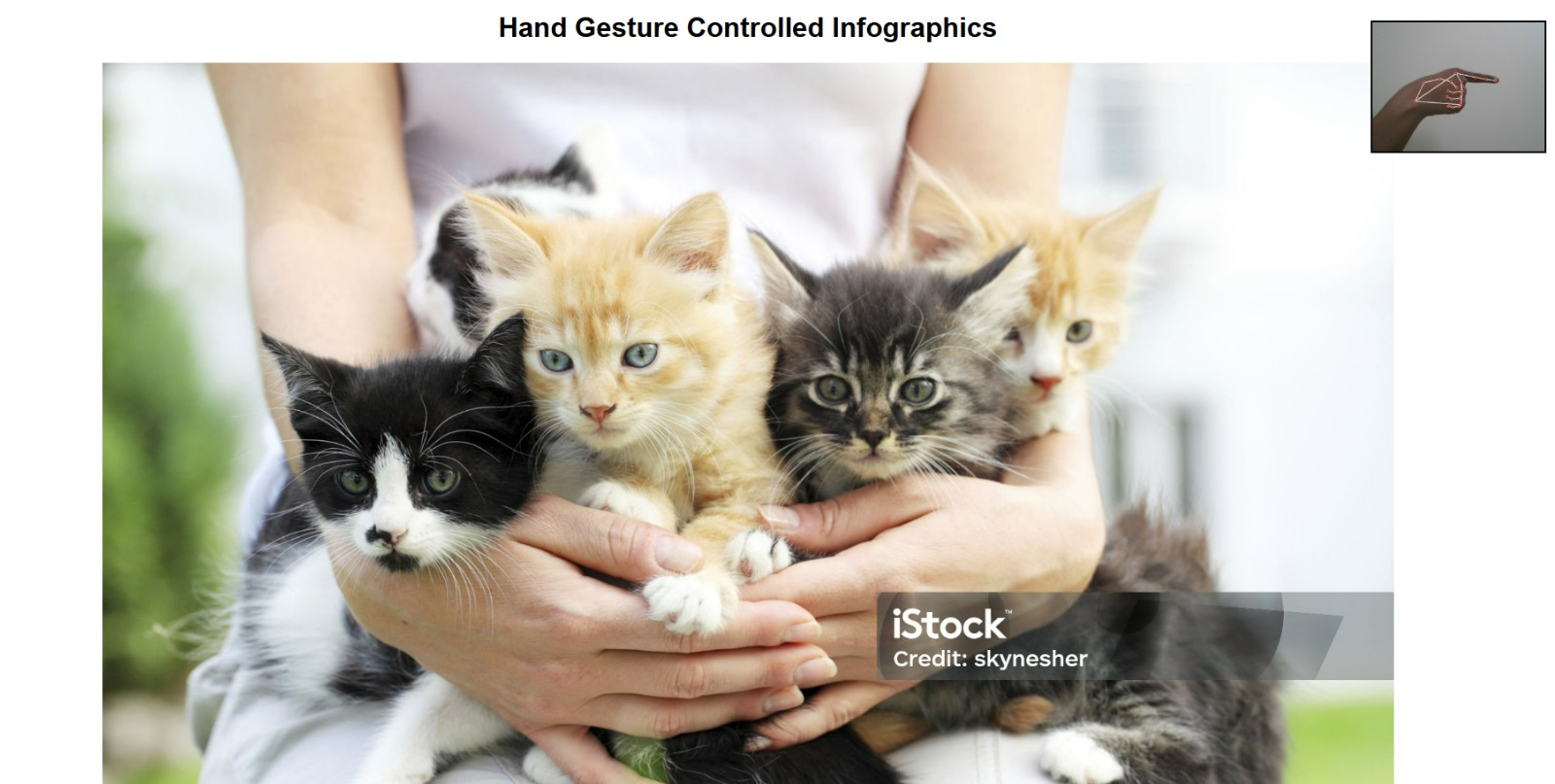
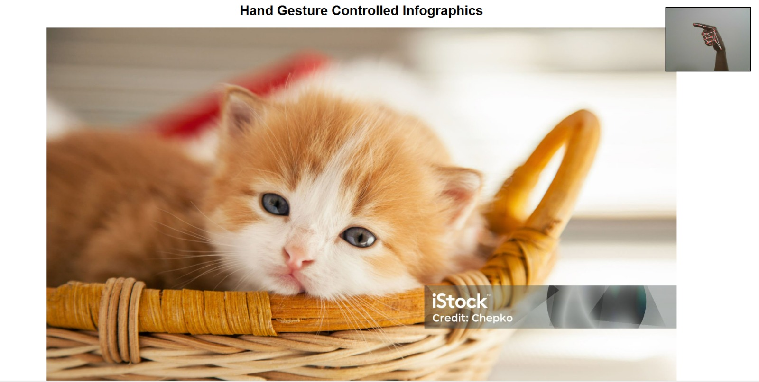
Implementation
Uses OpenCV to capture webcam feed
MediaPipe identifies gestures (swipe left, right, pause)
Flask routes process the recognized gestures
JavaScript updates slideshow dynamically

Slide 9
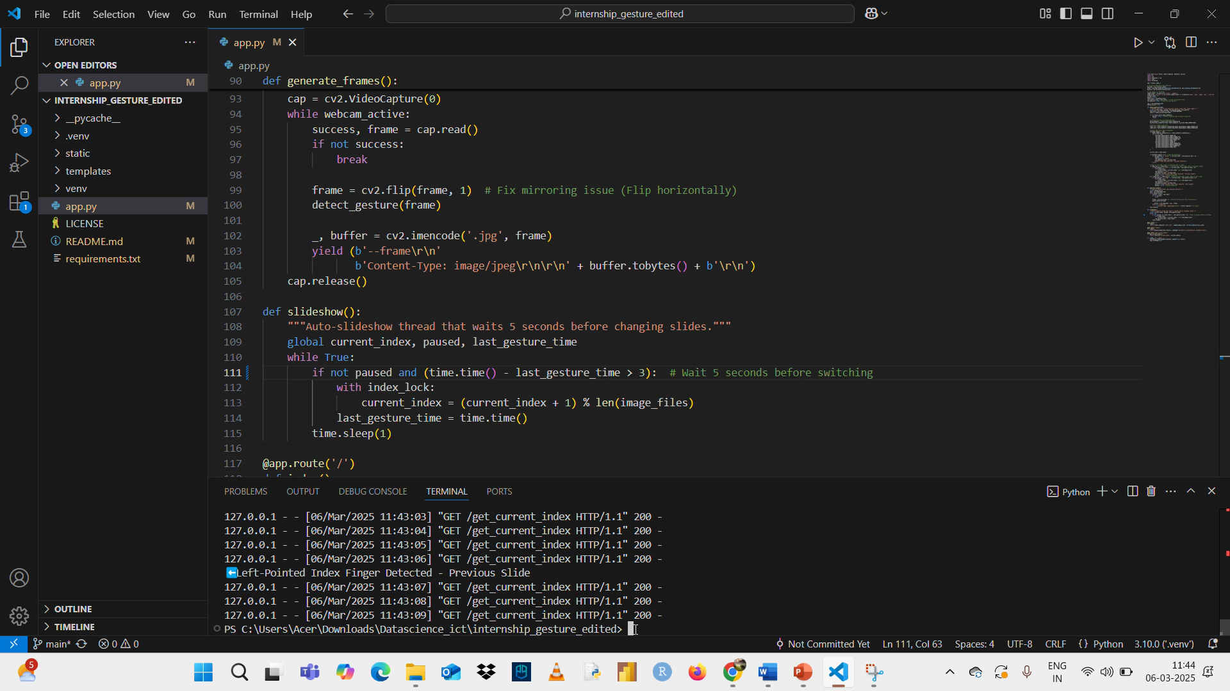
Demo & Working

Slide 10
Challenges & Solutions
Resolved parallel working of hand gesture detection and infographics.
Initially only open palm (pause) was working properly with the infographics , but the right pointed index finger(next slide) and left pointed index finger (previous slide) was not properly working.
Resolved web cam mirroring.
Introduced a delay (5s) after each gesture detection. Since continuously detecting gestures created some issues .
Hand detection accuracy improved by changing minimum tracking and detection confidence to 0.7.

Slide 11
Future Improvements
Support more gestures for extended functionality like zoom in, zoom out etc.
Improve UI with additional customization options.
Hand gesture controlled video playback.
Deploying the application online for broader accessibility.

Slide 12
Conclusion
A hand gesture-controlled infographics is developed using MediaPipe and Flask.
Slideshow updates every 5 seconds, with manual gesture controls(Open Palm (Pause), Left Pointed Index Finger (Previous Slide), Right Pointed Index Finger(Next Slide)), which enhances accessibility and interaction without physical touch

Slide 13
References
https://ai.google.dev/edge/mediapipe/solutions/vision/gesture_recognizer
https://intuitivetutorial.com/2024/04/11/user-interface-control-using-hand-gesture-recognition/
https://github.com/baukk/Gesture-Recognition
https://towardsdatascience.com/real-time-hand-tracking-and-gesture-recognition-with-mediapipe-rerun-showcase-9ec57cb0c831/

Slide 14
THANK YOU…

